Slide 1
Pitch Deck Template
University of Bonn Transfer Center enaCom Prototyping Grant
Dr. Alexander Küsshauer

Slide 2
Stay consistent with your structure, fonts, colors and style!
Basic Design Rules
You don‘t need a professional designer. Just follow these simple rules. And don‘t use bullet points. You are not in school. Use the slide master (see next page)

Slide 3
You can control the overall layout and formatting of all slides with the Slide Master
The Slide Master
Using the Slide Master ensures consistency in design and formatting throughout a presentation, saving time and maintaining a cohesive visual identity. In other words: If you change the color of your title, you only have to do it once!

Slide 4
Be visual (and avoid long continuous text)
Basic Design Rules
Your content may be complex, but must be easy to grasp. Use
arrows, diagrams, flowcharts, icons or other non-text elements to
minimize the workload of your reader's brain.

Slide 5
Add these tweaks to make your design flawless
Basic Design Rules
Tiny design improvements can subconsciously boost the jurys’ perception of your pitch - Add them once your deck is otherwise ready.

Slide 6
Action Titles deliver your core message directly into the jury’s brain.
If you only remember this…
To make sure your message gets across, you need to tell at least 60% of each slides content in the titel!
„Problem“, „Solution“, „Business Model“ are NOT good titles but your navigation system (Top left corner)! You don‘ need an agenda!

Slide 7
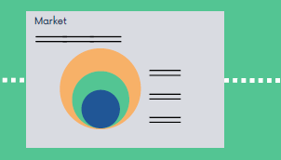
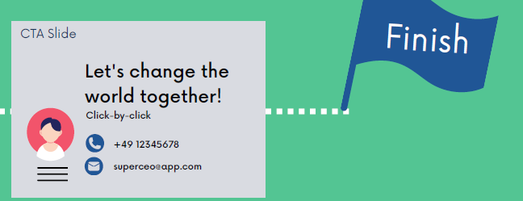
You can never go wrong with this slide order to tell your story
Slide-By-Slide Overview

Slide 8
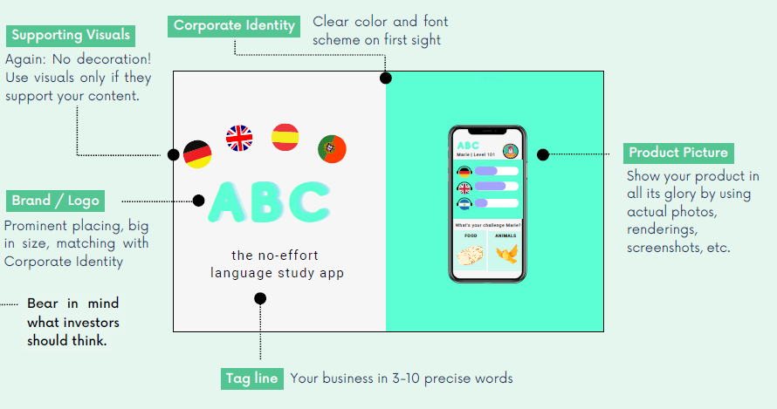
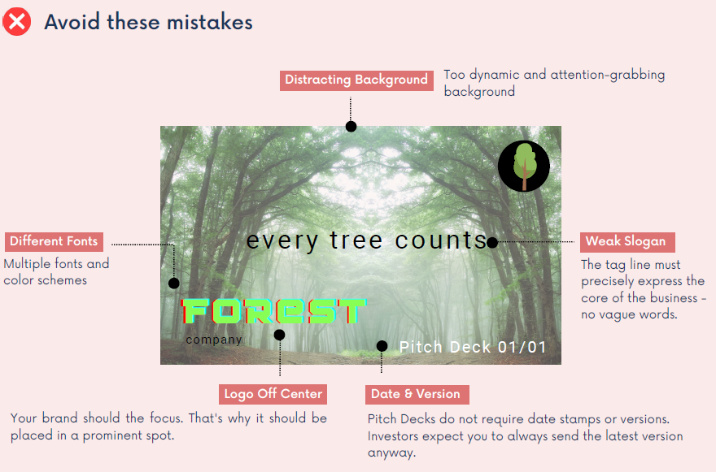
Use logo, Tag Line, Supporting visuals, product picture for the perfect cover
The Cover Slide

Slide 9
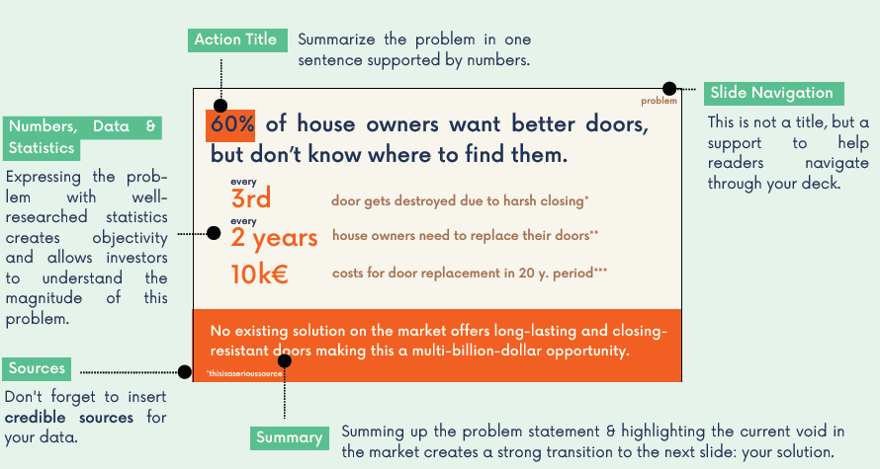
Show the jury that the problem REALLY exists… and how BIG it is
The Problem Slide
Good startup solve relevant problems! If you don‘t know yet, do research. Let BING (AI) help you with that

Slide 10
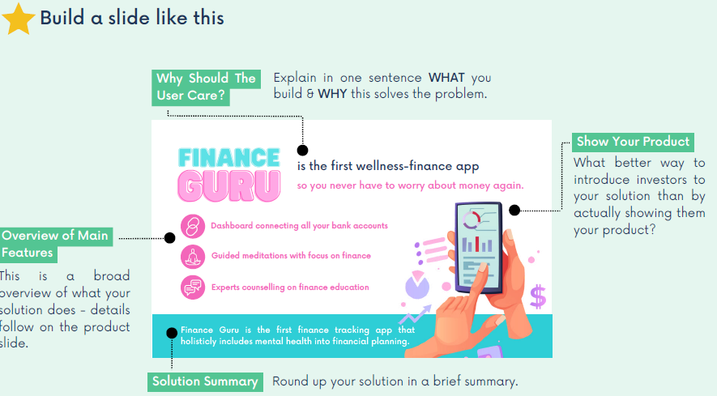
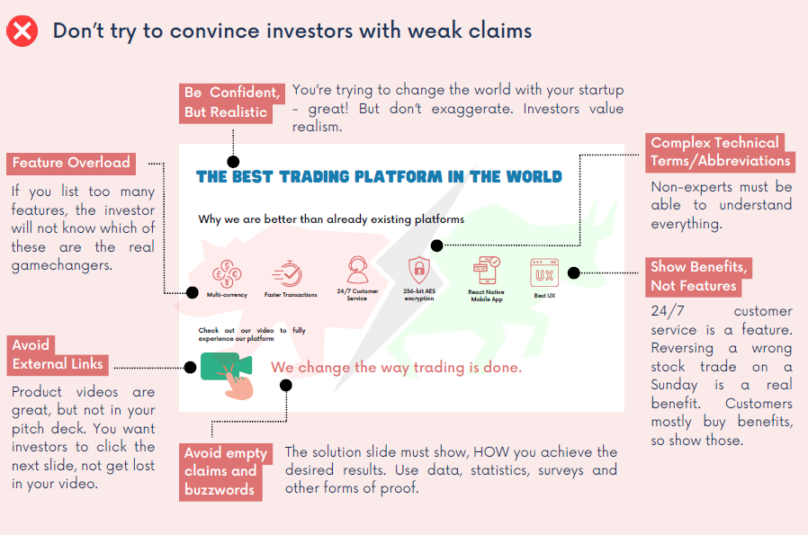
Explain your solution in an elegant way and how it is intended to work!
The Solution Slide

Slide 11
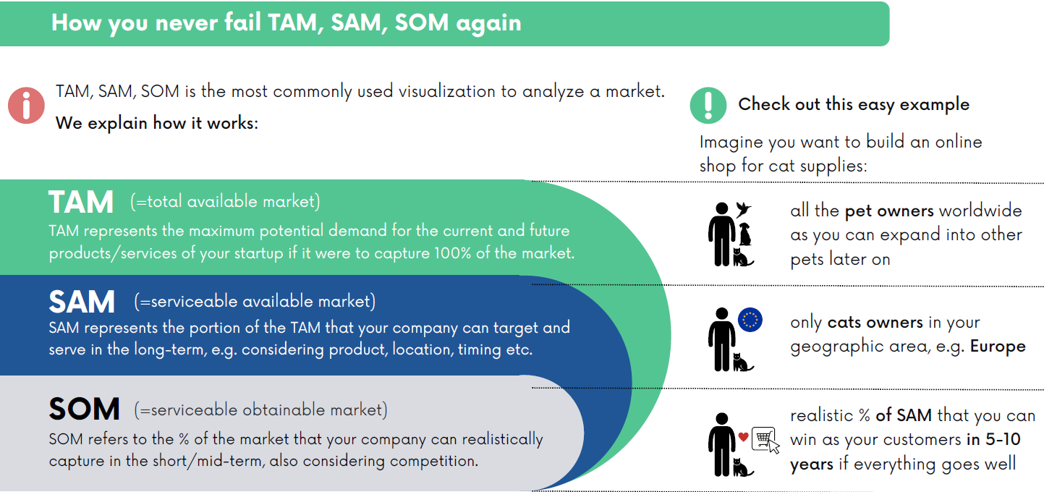
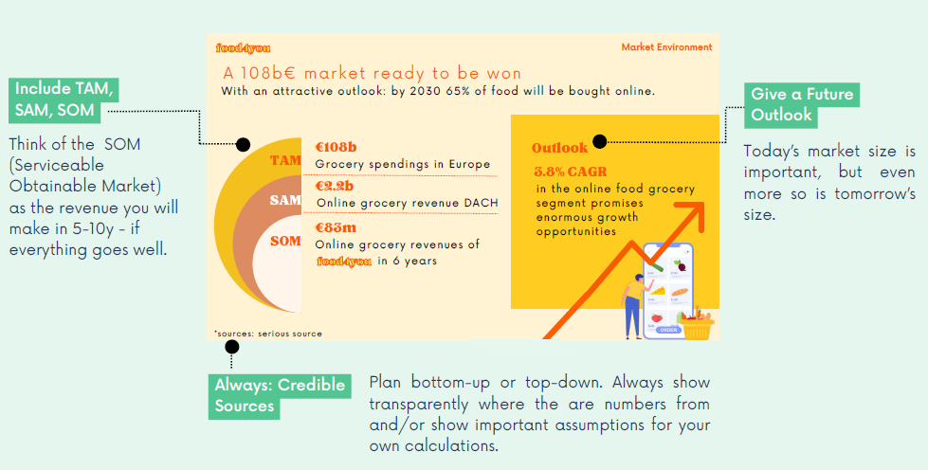
Show the jury how tempting your market is
The Market Slide
You can start with a niche product, but your overall market needs to be BIG.

Slide 12
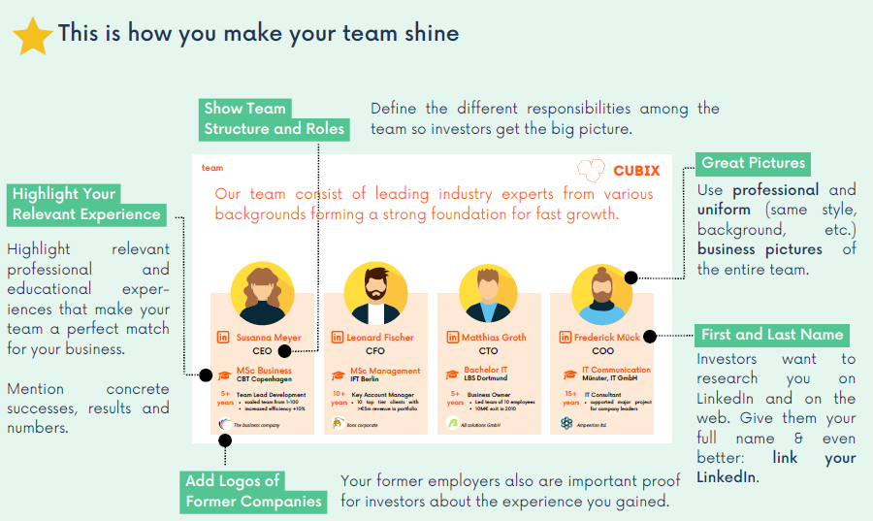
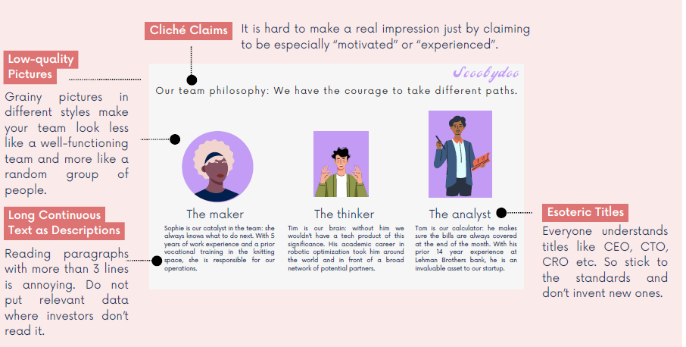
Show the jury your team. Provide concrete data. Looking for team members, say so!
The Team Slide
Don‘t be afraid. The jury knows that you are early stage. If you have a team, good ☺ If you are still looking for team-members, say what you need! Be open and transparent on this topic. Differentiate between team and advisors.

Slide 13
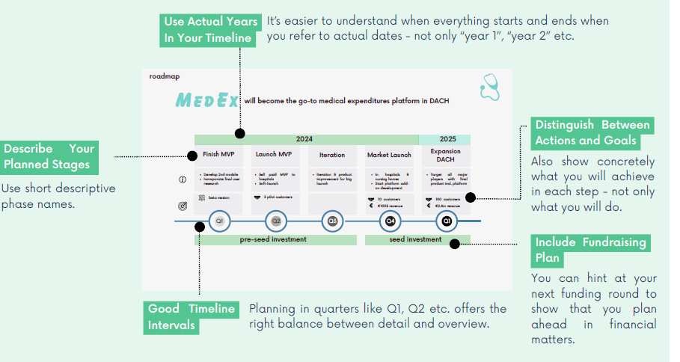
Show the jury your ambitious goals for the Prototyping Grant.
The Roadmap
Outline your milestones during the grant and explain how you want to accomplish each of them. Additionally, a brief outlook on how and when you want to start the business is also helpful (which additinal steps beside the grant need to be taken)

Slide 14
Make 100% clear what you want from the jury/audience and how they can contact you
The Call to Action (CTA)
Don‘t just say „Thank you“. Mention how much money you need and summarize your motivation/vision in one sentence

Slide 15
Let‘s rock the idea competition together
Get Ready for Thursday
See you on Thursday, November 30th @ Brühler Straße 7 (10am-5pm)
Contact: Dr. Alexander Küsshauer (kuesshauer@verwaltung.uni-bonn.de)
Further information on the Pitch Deck: https://www.addedval.io/

